Slide 1
Flexbox
Front-End Web Development

Slide 2
Lesson 04 Change Log FEWD 3.1–3.2
Below are the specific changes made in this lesson.
Returning Instructor Directions:
Click on the hyperlinks below, and it will direct you to the specific slide.
Copy the entire slide, and paste in your existing curriculum deck.
Pre-Class Materials and Preparation - Added two new CodePens — Floats Example and Flexbox Intro Example — to Reference Code.
Share how the lesson went through our Instructor Lesson Exit Ticket - the Curriculum Feedback form: http://ga.co/curriculum-feedback

Slide 3
Pre-Class Materials and Preparation
Review all slides, lab activities, and code-alongs.
There are prompts in the speaker notes with opportunities for instructor customization.
Materials
Reference Code
Starter Code in CodePen
Solution Code in CodePen

Slide 4
Flexbox
Overview
This lesson introduces flexbox rules in CSS, allowing for flexible, modern layouts.
Learning Objectives
In this lesson, students will:
Use flexbox properties to create responsive layouts.
Apply flexbox properties to container elements to organize flex-item elements.
Apply flexbox properties to flex-items to differentiate unique elements.
Duration: 180 minutes

Slide 5
Suggested Agenda
Time | Activity | Purpose
0:00–1:15 | Flexbox Instruction/Walk-Through | Demonstrate flexbox properties using the walk-through code as examples.
1:15–1:30 | Nav With Flexbox | Apply the flexbox parent and child rules to create a navbar. Encourage students to look at the examples from the walk-through if they get stuck — it will be tough going from a length, list-based explanation to actually applying the rules.
1:30–2:00 | Children Properties | Introduce properties applicable to specific children elements in flexbox containers.
2:00–3:00 | Airbnb Mockup | Students get a lengthier challenge based on a real-life website from a modern, techy company.

Slide 6
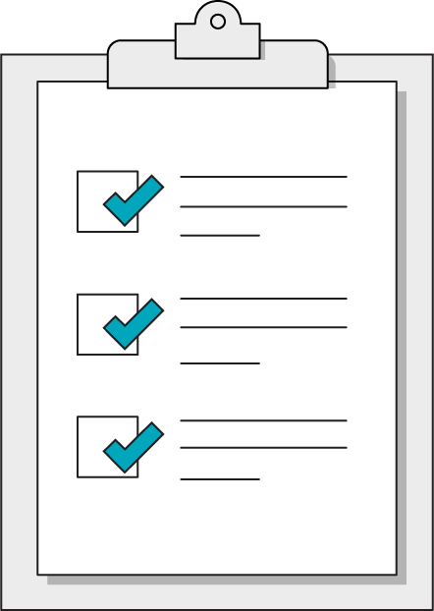
Today’s Learning Objectives
In this lesson, you will:
Use flexbox properties to create responsive layouts.
Apply flexbox properties to container elements to organize flex-item elements.
Apply flexbox properties to flex-items to differentiate unique elements.
6 | © 2020 General Assembly
Notes:
DURATION: 1 minute
TEACHING TIPS:
Learning objectives help frame the lesson and give students an idea of what to expect and focus on.
Explain to students how this lesson fits into the overall course to help them make connections with content from other lessons.

Slide 7
Warm-Up!
Front-End Web Development

Slide 8
Practicing the Box Model
60 minutes
Use what you have learned about the box model and selectors to create a style guide
Style guides are critical to all large scale projects
Open the project folder starter code: Exercises and Homework\Lesson 04\01 Nested Selectors Style Guide
The README.md file contains a list of necessary styles
Notes:
TEACHING TIPS:
This assignment may be beyond what students can do. Support them and make them push into new material. Again, this could be a partial code-along/self-guided activity.
The goal would be that they get a little frustrated and push into flexbox on their own. Weaker students may feel lost, but support a productive struggle. Potentially bring students together for code-alongs as they work through this. At this point, encourage exploration more than anything!

Slide 9
CSS: Layout Introduction
Front-End Web Development

Slide 10
Tables
Before there was CSS, there was table-based layout. Layout is achieved by nesting tables inside of tables.
We still use table-based layout for html emails.
And NOTHING else.
Title
First Column | Second Column | Third Column
10 | © 2020 General Assembly
Notes:
TEACHING TIPS:
Explain that, although floats are no longer used for page layouts, they do have one existing niche in web design and that is to allow text to wrap around images, like in these CodePens:
https://codepen.io/jkeohan/pen/422788fb0859818152accc10f0714b2c
https://codepen.io/jkeohan/pen/eepKXQ

Slide 11

Floats
CSS was written a LONG time ago, in a galaxy far, far away (the 1990s).
That’s why we had the float-based system — it was intended for you float images in a sea of words, like in a magazine.
11 | © 2020 General Assembly
Notes:
TEACHING TIPS:
Explain that, although floats are no longer used for page layouts, they do have one existing niche in web design and that is to allow text to wrap around images, like in these CodePens:
https://codepen.io/jkeohan/pen/422788fb0859818152accc10f0714b2c
https://codepen.io/jkeohan/pen/eepKXQ

Slide 12
The Problem With Floats
Although floating was intended for wrapping text around an image newspaper-style, the lack of alternatives offered by CSS for page layouts meant it became abused for all manner of layout applications.
Unfortunately, float properties can cause all sorts of unintended interactions with other elements on the page.
This means you have to nudge a lot of other elements out of the way, especially if you’re using multiple floated elements. You may wind up with extra html elements and css that you do not need!
12 | © 2020 General Assembly
Notes:
TALKING POINTS:
This is a good opportunity to talk about backward compatibility — we have to keep floats around, as getting rid of them would break tons of websites and tools that rely on the old methods. There are TONs of “legacy” features in technology that have to stay where they are, but that doesn’t mean we should use them!
TEACHING TIPS:
Show students https://caniuse.com/#search=flexbox so they can see just how supported flex has become across all browsers.

Slide 13
There are two relatively new tools in the CSS layout toolbox: flexbox and CSS Grid. Previously we had to create layout with floats and clears, which now can return to their original purpose: floating images.
13 | © 2020 General Assembly

Slide 14
How Does Flexbox Work?
Front-End Web Development

Slide 15

Key Idea: Remember the DOM Tree
It’s a visual diagram of a webpage’s HTML structure.
Notes:
TEACHING TIPS:
Have students recall the last lesson and the idea of a DOM tree. Talk about this with them. It will now become clear why it was introduced last class.

Slide 16
We Can Visualize our HTML
<main>
<section class=”ichi”>
<p>Content</p>
</section>
<section class=”ni”>
<p>More content</p>
</section>
</main>
p
section
p
Remember, by default, HTML elements are blocks that stack vertically on a page, like we see here on the right.
section
main
Notes:
TALKING POINTS:
Note how <main> splits off into two “directions” with each section; sections could split off with several children as well, as each “branch” can itself have many branches.

Slide 17
Flexbox Goes on the Parent Element
Flex containers are the elements that contain the elements you are trying to align.
Flex containers hold objects that contain child elements (like this bounce house). The parent element won’t flex, but it will tell its children to be flexible!
17 | © 2020 General Assembly
Notes:
TALKING POINTS:
The parent is where most of the flexing occurs. If you tell a container it should display as flex, it will arrange its child elements accordingly.

Slide 18
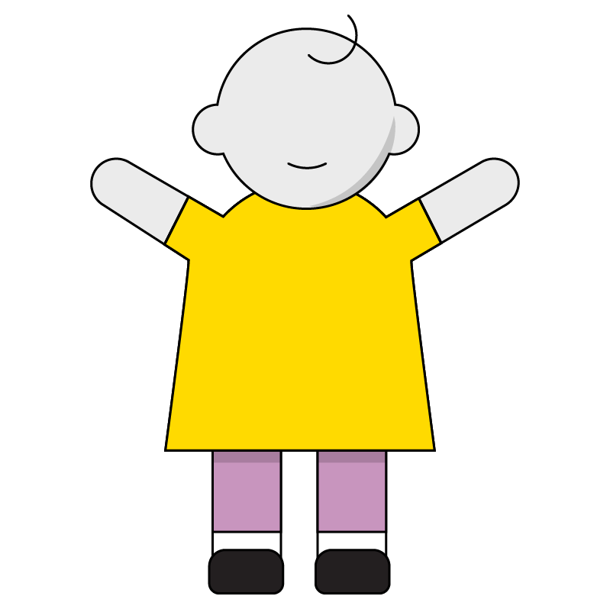
Children (Items)
Flex items are the children that go inside the parent container.
In simple layouts, the child elements may not receive any special styling — which may surprise you.
18 | © 2020 General Assembly
Notes:
TALKING POINTS:
Child items can be given specific flex properties as well to arrange them in specific orders or sizes. The general scheme of how you want the items to be arranged belongs to parents. Properties that involve “this specific item should do X” will be child properties.

Slide 19
display: flex; in Action
p
p
section
section
main
<main>
<section class=”ichi”>
<p>Content</p>
</section>
<section class=”ni”>
<p>More content</p>
</section>
</main>
/* css */
main {
display: flex;
}
When you put display: flex; into a parent element, its children become an orderly row. In this example, <main> controls the two <section> elements immediately beneath it in the DOM tree.
Notes:
TALKING POINTS:
Point out how <main> controls the sections — this is the key to understanding flexbox.

Slide 20
What Didn’t Happen in This Example
p
p
section
section
main
<main>
<section class=”ichi”>
<p>Content</p>
</section>
<section class=”ni”>
<p>More content</p>
</section>
</main>
/* css */
section {}
p {}
Notice that, despite the <section> elements being in a row, nothing happened to the <p>. This is because flexbox only affects one level down in the DOM — no more. Also notice that the <section> elements didn’t receive any styles. They are controlled solely by the parent.
Notes:
TALKING POINTS:
Point out how <main> controls the sections — this is the key to understanding flexbox.

Slide 21
When Building Flexbox Layouts...
...Every container must have…
display: flex;
...which also includes the following properties set by default:
flex-direction: row;
justify-content: flex-start;
align-items: stretch;
What do you think those other properties do?
21 | © 2020 General Assembly
Notes:
TALKING POINTS:
These are all default properties that can be overwritten if needed but represent a sensible starting point for all things flex.
The following code-along/slides will address alternative options for each of these properties.

Slide 22
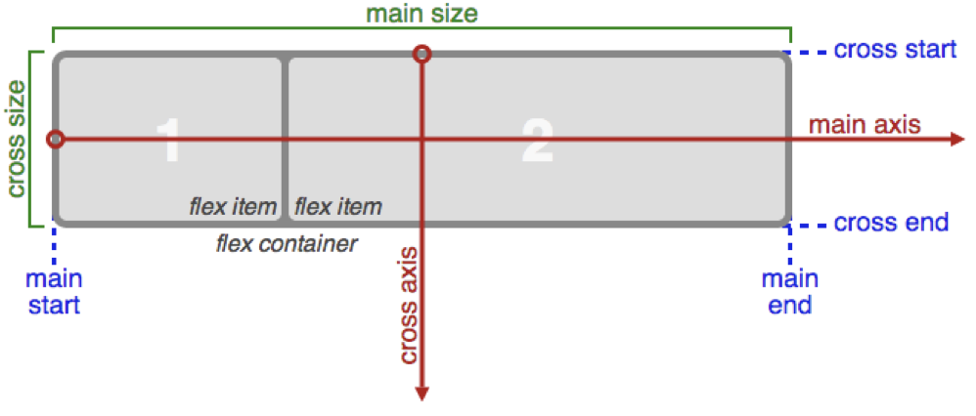
Flexbox Gives You Control Over Alignment
The main axis is horizontal by default and controlled by justify-content.
The cross axis is controlled by the align-items property of the parent.
Direct children automatically fall into place.
22 | © 2020 General Assembly
Notes:
TALKING POINTS:
By default, flex items will be flexible along the horizontal axis. You can change it to flex vertically instead but, either way, you have to set a “main” axis that will flex and a “cross” axis that will not. What if you want two main axises? You can’t have them… yet.

Slide 23
Flexbox Positioning
When you put justify-content: center; onto a parent element, its children squeeze together in the center of the container along the primary axis (usually horizontal).
align-items: center; on the parent element moves children to the cross-axis center (usually vertical) of the container.
Once again, notice there are no flex positioning styles on the children (.item).
.item
.item
.item
.item
.container
/* CSS */
.container {
display: flex;
justify-content: center;
align-items: center;
}
.item {
background-color: teal;
height: 100px;
margin: 5px;
width: 100px;
}
23 | © 2020 General Assembly
Notes:
TALKING POINTS:
Notice that the child elements don’t yet have “flex” properties. Again, the parent manages the spacing and layout of the children and has the display of flex. justify-content and align-items are also properties based on flexbox.

Slide 24
Flexing Our Layout Muscles
Refer to this interactive CodePen for the following examples of how to use flex properties on parent and child elements. They are many more properties:
Reference code:
https://drive.google.com/drive/folders/1tSlI6rPlQ8iJAzUDxXmFEuPR0Yarsrf4?usp=sharing
24 | © 2020 General Assembly
Notes:
TEACHING TIPS:
For a more detailed display of flexbox functionality, show the class these CodePens:
https://codepen.io/jkeohan/pen/zdKJOY
https://codepen.io/GAmarketing/pen/KKKBJrM

Slide 25
Flex Parent Properties Reference
Front-End Web Development
Notes:
TEACHING TIPS:
It's good to give a sense of these properties, but consider this section more of a reference area than a direct teaching plan. Don't feel obligated to present the entire list one at a time.

Slide 26
flex-direction
1
Think about orientation — flexbox layouts are inherently vertical or horizontal.
flex-direction: column;
2
3
4

Slide 27
flex-direction (Cont.)
4
You can easily flip the display order without reordering your HTML!
flex-direction: column-reverse;
3
2
1

Slide 28
flex-direction (Cont.)
You can also do layouts in a row. This is the default, and flexbox will cram every child into this single row.
flex-direction: row;
1
2
3
4

Slide 29
flex-direction (Cont.)
You can flip rows, too! This is very advantageous for users accustomed to right-to-left languages.
flex-direction: row-reverse;
4
3
2
1

Slide 30
flex-wrap
By default, all boxes are stuffed into one row.
flex-wrap: nowrap;
1
2
3
4

Slide 31
flex-wrap (Cont.)
But you can make them pop out into additional rows as needed.
flex-wrap: wrap;
1
2
3
4
5

Slide 32
flex-wrap (Cont.)
They can display right to left and bottom to top as well.
flex-wrap: wrap-reverse;
4
5
1
2
3

Slide 33
justify-content
This controls how boxes are spaced in flexbox rows/columns.
flex-start pushes everything toward the start direction.
justify-content: flex-start;
1
2
3

Slide 34
justify-content (Cont.)
Centering is easy! Note, however, that auto margins don't work in flex land.
Either go flex all the way or don’t go flex at all.
justify-content: center;
1
2
3

Slide 35
justify-content (Cont.)
Push everything to the end direction with flex-end.
This is similar to text-align: right; but for layouts!
justify-content: flex-end;
1
2
3

Slide 36
justify-content (Cont.)
Push stuff as far apart as possible using:
justify-content: space-between;
1
2
3

Slide 37
justify-content (Cont.)
Center with respect to total row/column width, leaving equal spacing between each item.
justify-content: space-around;
1
2
3

Slide 38
align-items
Center children items vertically.
align-items: center;
1
2
3

Slide 39
align-items (Cont.)
Align children with the top of the box, even if they have different heights.
align-items: flex-start;
1
2
3

Slide 40
align-items (Cont.)
Bottom align children, even if they have different heights.
align-items: flex-end;
2
1
3

Slide 41
align-items (Cont.)
Align children by the middle baseline of the text in the child.
Note: The orange line is for demonstration only — you won’t see this IRL.
align-items: baseline;
1
3
2

Slide 42
align-items (Cont.)
Stretch children to fill the container.
align-content: stretch;
1
2
3

Slide 43
Layout Challenge Part 1
10 minutes
Open up the layout challenge folder and review the PDF. Build the first two layouts!
Starter code:
https://drive.google.com/drive/folders/1Q0Fw4JfOcuFBKtvgBSwo2W0ZIIpje4Xs?usp=sharing
Solution code:
https://drive.google.com/drive/folders/1Q0Fw4JfOcuFBKtvgBSwo2W0ZIIpje4Xs?usp=sharing
Notes:
TEACHING TIPS:
To convey how important using flexbox is for navigational elements, assign students this article to read, which recreates the navs of some of the most popular websites like Facebook, Twitter, GitHub, and Medium: https://medium.com/flexbox-and-grids/the-most-popular-navigation-bars-created-with-flexbox-6c0f59f55686

Slide 44
Flex Child Properties Reference
Front-End Web Development

Slide 45
order
Change the order in which children render within a row.
order: 3;
order: 1;
order: 2;
3
1
2

Slide 46
flex-grow
Control the rate at which individual children grow in width across viewports.
flex-grow: 2;
flex-grow: 0.5;
flex-grow: 1;
1
2
3
4

Slide 47
align-self
This works like align-items but for an individual child, so you can override on a per-item basis.
align-self: flex-end;
1
3
2

Slide 48
Nested Flexbox Layouts
Front-End Web Development

Slide 49
Can You Flex Within Flex?
You can nest a flex container inside of a flex container — no problem.
Flex container properties only adjust their direct children, so you may need several layers of flexing to drill down to further descendent elements!
Notes:
TALKING POINTS:
This is a common implementation in which flexbox can be reapplied to several nested levels.

Slide 50
Nested Flexboxes Require Dual Flex Declarations
p
p
section
section
main
<main>
<section class=”ichi”>
<p>Content</p>
</section>
<section class=”ni”>
<p>More content</p>
</section>
</main>
/* css */
main {
display: flex;
}
section {
align-items: center;
display: flex;
justify-content: center;
}
<section> now plays two roles: It’s the child of <main> but also the parent of <p> elements. When flex is applied to any element — even a flex child — it will control the children directly beneath it. You nest flexboxes indefinitely using this method.
Notes:
TALKING POINTS:
Point out how <main> controls the sections — this is the key to understanding flexbox.

Slide 51
Layout Challenge Part 2
60-90 minutes
Continue with the layout challenge and complete layouts 3, 4, and 5
Starter code:
https://drive.google.com/drive/folders/1Q0Fw4JfOcuFBKtvgBSwo2W0ZIIpje4Xs?usp=sharing
Solution code:
https://drive.google.com/drive/folders/1Q0Fw4JfOcuFBKtvgBSwo2W0ZIIpje4Xs?usp=sharing
51 | © 2020 General Assembly
Notes:
TALKING POINTS:

Slide 52
Airbnb Mockup
60-90 minutes
Many professional websites use flex properties, including Airbnb! Practice your new flex skills by recreating the examples provided in the screenshots.
Starter code:
https://codepen.io/GAmarketing/pen/LYYBaEX
Solution code:
https://codepen.io/GAmarketing/pen/Yzzjgqb
52 | © 2020 General Assembly
Notes:
TALKING POINTS:
Here is the starter code: https://codepen.io/GAmarketing/pen/LYYBaEX
Here is the solution code: https://codepen.io/GAmarketing/pen/Yzzjgqb

Slide 53
Key Takeaways
For Next Time
Flex, Don’t Float!
Layouts in the Second Dimension
Container elements given display: flex can arrange their children.
Children elements can be given specific flex properties just for them.
Flex always works along one main axis.
Complete Homework No. 2
CSS Grid is coming up!
Notes:
TEACHING TIPS:
To convey how important using flexbox is for navigational elements, assign students this article to read, which recreates the navs of some of the most popular websites like Facebook, Twitter, GitHub, and Medium: https://medium.com/flexbox-and-grids/the-most-popular-navigation-bars-created-with-flexbox-6c0f59f55686

